Slide 1


Accelerating Design Exploration and
Optimization with Surrogate Physics Models
Team THU
Dexin Ji, Xuetao Qiu
Professor Xiaowei Yue
August 17, 2025

Slide 2
Outline
1
Model Prediction
2
Model Prediction Result Analysis
3
Inverse Design
4
Inverse Design Result Analysis
5
Conclusion
6

Slide 3
1. Model Prediction

Slide 4
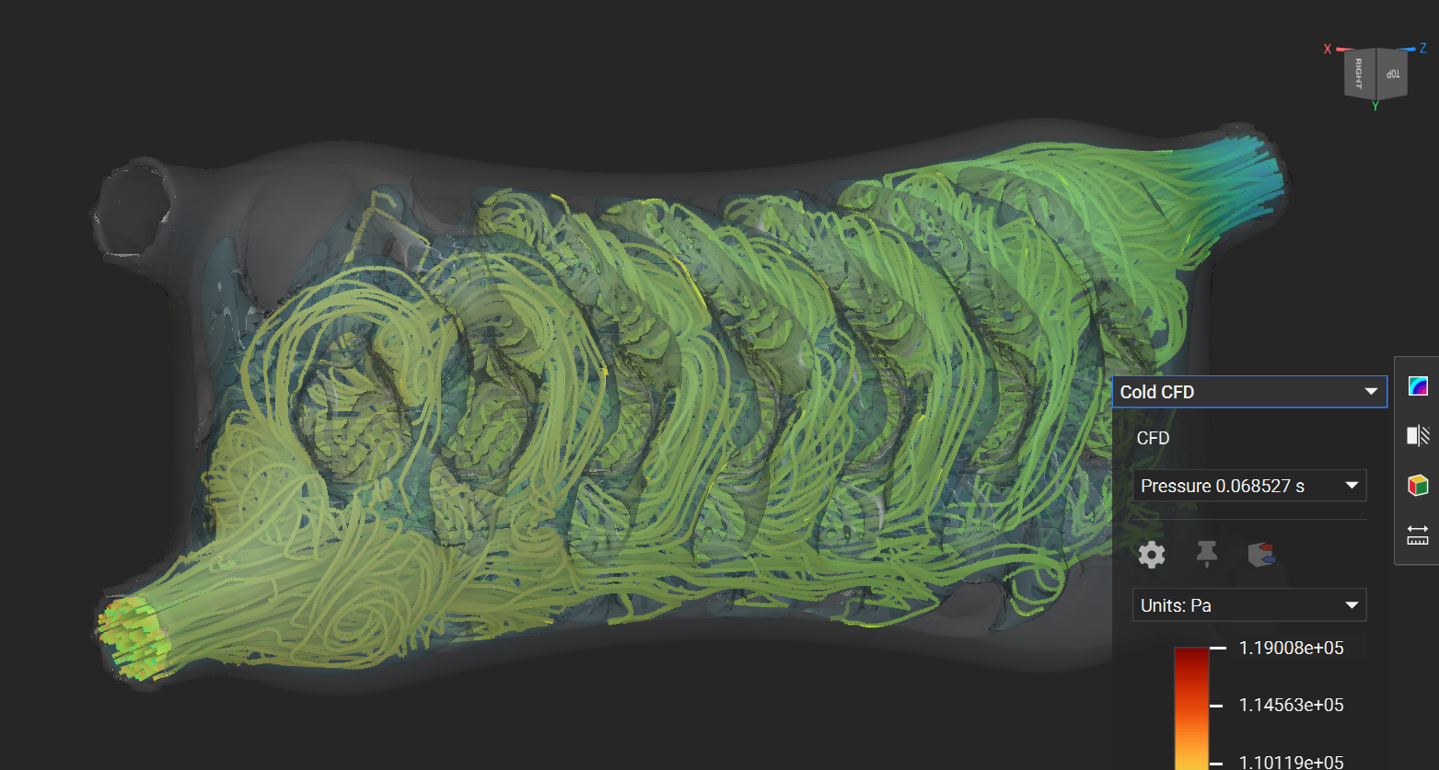
1. Background - Problem Introduction
Simple Heat Exchanger
Tranditional CFD
Long calculation time
Cosuming more resources
Accurate result
……
Surrogate model
Short calculation time
Cosuming less resources
Relatively accurate result
Make full use of data to facilitate iterations
……
It is highly necessary to use surrogate models to assist in modeling, prediction and parameter iteration.

Slide 5
1. Background - Modeling process
Streamline the modeling process
Various methods such as regression, GP, NN, and NPs are employed to establish the model.
Establish surrogate model
Define the problem
A good experimental design, such as LHS, can fully cover the parameter space and improve the prediction effect.
Experimental design for data acquisition
Evaluation and optimization
Use the surrogate model to search for the optimal parameter combination and support design optimization.
Reverse engineering
Exploratory Data Analysis
LHS is used to construct 500 groups of samples for training the model, and the provided 125 groups of samples are used for testing.
Iterative optimization
We need reasonable experimental design, surrogate modeling and parameter optimization.

Slide 6
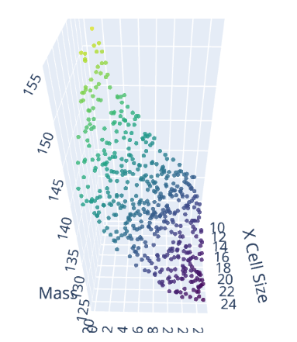
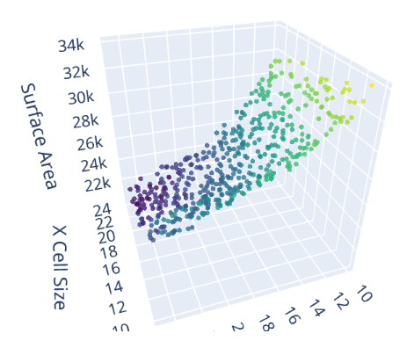
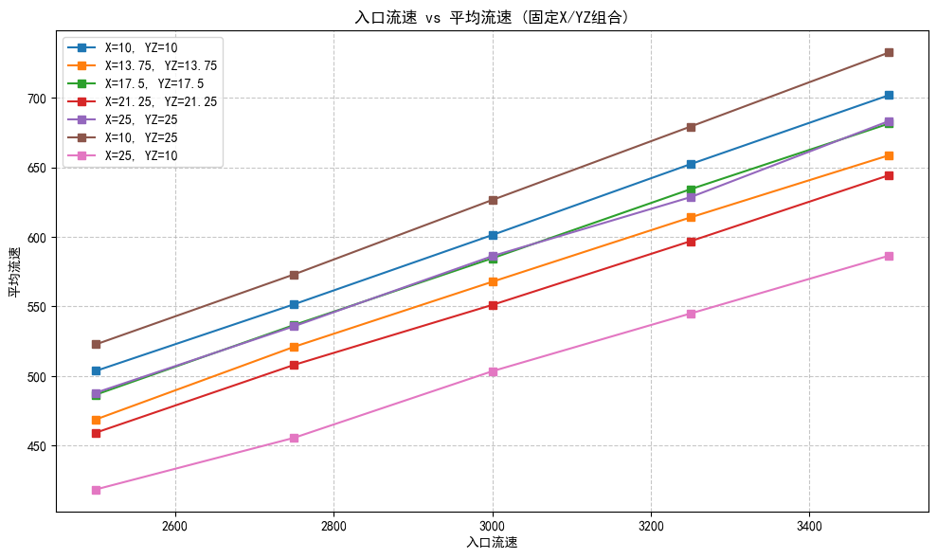
1. Background - Modeling process
conducting exploratory data analysis to uncover data patterns
The visualized results of MASS and SURFACE AREA with respect to X and YZ cell size
The Velocity Inlet also has a significant impact on the AvgVelocity and PressureDrop.
The data reflects certain physical laws and helps build models, rather than simply “data in, data out”.

Slide 7

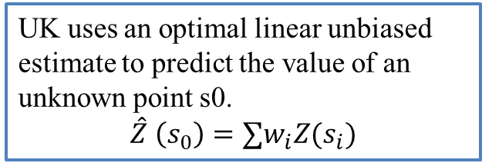
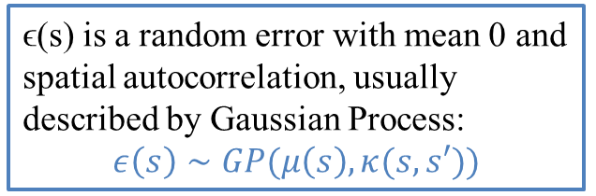
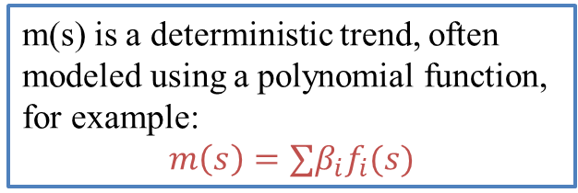
1. Model Prediction - Universal Kriging Model
Universal Kriging is the core model we adopted to build the surrogate model which predicts best.
Universal Kriging (UK) is a geostatistical method for spatial interpolation and prediction. It builds on the foundation of Kriging but is specifically adapted for situations where there is a trend in the data (i.e., the mean of the data is not constant).
The core idea of UK is to decompose the value of a spatial variable Z(s) into two components:
The deterministic trend component m(s): This is a smooth, predictable trend determined by the spatial coordinates. It represents the large-scale variation of the data.
The random error component ϵ(s): This is a zero-mean, spatially autocorrelated random term. It represents small-scale fluctuations and local variations in the data.
$$Z\left(s\right)=m\left(s\right)+ε(s)$$
UK uses an optimal linear unbiased estimate to predict the value of an unknown point s0​.
$$\hat{Z} \left(s_{0}\right)=∑w_{i}Z(s_{i})$$
m(s) is a deterministic trend, often modeled using a polynomial function, for example:
$$m\left(s\right)=∑β_{i}f_{i}(s)$$
ϵ(s) is a random error with mean 0 and spatial autocorrelation, usually described by Gaussian Process:
$$ε\left(s\right)∼GP(μ\left(s\right),κ(s,s′))$$

Slide 8
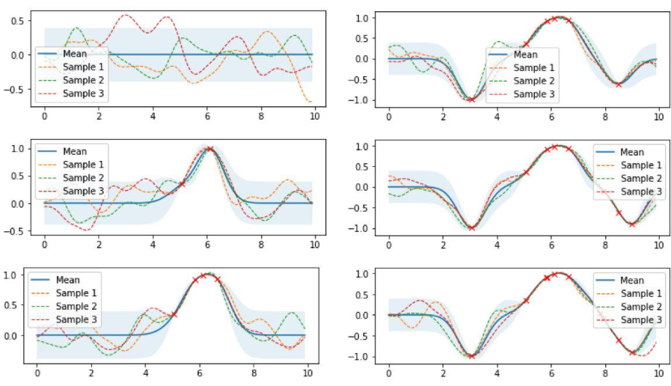
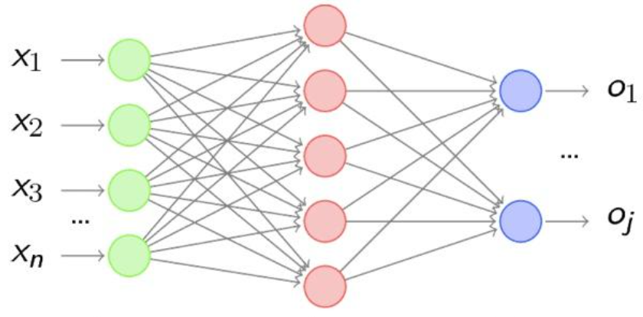
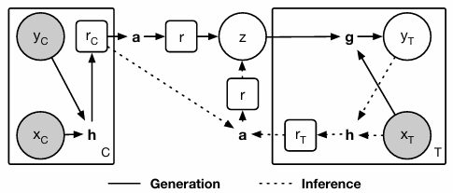
1. Model Prediction - Other Models
We also tried several other methods, but the results were not the best.
Gaussian process and
Orthogonal Gaussian process models
The common methods for modeling small datasets can provide uncertainty predictions, but have high computational complexity.
Artificial neural network model
Common nonlinear modeling methods usually have good results.
Neural Process Model
Combining the methods of Gaussian processes and neural networks, and providing uncertainty prediction.
[1611.00203] Orthogonal Gaussian process models
[1807.01622] Neural Processes

Slide 9
1. Model Prediction - Model Comparison
Model Characteristics | Universal Kriging (Our Choice) | Neural Networks | Gaussian Process Regression | Neural Processes
Sample Efficiency | Effective with small samples | Requires large datasets | Effective with small samples | Effective with small samples
Training Speed | Fast | Slow | Fast | Middle
Interpretability | High | Low | Low | Middle
Global Trend Capture | Explicit | Implicit | Implicit | Implicit
Uncertainty Quantification | Built-in prediction variance | No | Native (probabilistic) | Built-in prediction variance
Physical Consistency | Stronge | Weak | Moderate | Moderate

Slide 10
1. Model Prediction - Implement Steps
1. Design experiment
2. StandardScaler
3. Polynomial Regression
Use Latin hypercube experimental design to obtain 500 new groups of samples for training.
Improve model stability,
Accelerate convergence
Improve generalization capabilities
Use polynomial regression to model the deterministic trend of the data, which corresponds to the mean function m(s) in universal kriging.
4. Gaussian Process Regression
5. Prediction
6. Optimazion
Use Gaussian process regression (GPR) to model the spatial autocorrelation of residuals, which corresponds to the covariance function in universal kriging. Including Gaussian kernel, matern kernel, etc.
Combine trend and residual forecasts and denormalize them for prediction
By establishing prediction functions of multiple output variables, we can establish optimization objectives and constraint relationships and find the optimal parameter combination.

Slide 11
2. Model Prediction Result Analysis

Slide 12
2. Model Prediction Result Analysis
Variable | degree | RBF RMSE | RBF MAE | Matern1.5 RMSE | Matern1.5 MAE | Matern2.5 RMSE | Matern2.5 MAE | Periodic RMSE | Periodic MAE
AvgVelocity | 0 | 14.2149 | 11.2875 | 14.5684 | 11.0695 | 14.1564 | 11.0414 | 14.6757 | 11.6408
 | 1 | 17.4368 | 11.8672 | 17.7711 | 12.1826 | 17.6812 | 12.0922 | 20.7495 | 15.6523
 | 2 | 17.2048 | 11.1111 | 16.9798 | 10.7569 | 17.0076 | 10.8412 | 19.4275 | 14.4096
 | 3 | 11.8976 | 8.4749 | 11.7887 | 8.4803 | 11.7936 | 8.4293 | 14.5391 | 11.6571
--- | --- | --- | --- | --- | --- | --- | --- | --- | ---
Mass | 0 | 0.2422 | 0.1931 | 0.2707 | 0.1952 | 0.2437 | 0.1883 | 9.272 | 7.5393
 | 1 | 0.2692 | 0.205 | 0.2783 | 0.2016 | 0.2539 | 0.1928 | 2.2634 | 1.6862
 | 2 | 0.2807 | 0.2119 | 0.2711 | 0.2047 | 0.2695 | 0.2055 | 0.5801 | 0.4042
 | 3 | 0.2107 | 0.1688 | 0.2191 | 0.1609 | 0.2191 | 0.169 | 0.2094 | 0.1611
--- | --- | --- | --- | --- | --- | --- | --- | --- | ---
PressureDrop | 0 | 672.1881 | 437.3158 | 690.7897 | 434.0546 | 677.2306 | 430.3095 | 694.9336 | 451.4041
 | 1 | 713.8905 | 459.094 | 729.5994 | 457.9044 | 717.0079 | 452.6792 | 1121.288 | 839.6136
 | 2 | 737.7105 | 454.5828 | 750.0922 | 464.585 | 744.8617 | 459.2096 | 849.3918 | 553.1302
 | 3 | 679.7963 | 471.7467 | 710.0756 | 482.2737 | 677.8621 | 469.631 | 670.3896 | 457.7209
--- | --- | --- | --- | --- | --- | --- | --- | --- | ---
Surface Area | 0 | 242.434 | 218.0024 | 262.057 | 231.9769 | 255.5937 | 229.5522 | 3930.2648 | 3298.6608
 | 1 | 246.6162 | 222.2958 | 261.0037 | 233.0531 | 254.3785 | 226.845 | 1435.0804 | 1112.6415
 | 2 | 287.7099 | 229.841 | 291.1607 | 232.7559 | 289.7382 | 231.155 | 462.9485 | 400.7827
 | 3 | 187.7174 | 147.1246 | 194.851 | 156.5557 | 191.7687 | 153.1274 | 235.5678 | 205.9966

Slide 13
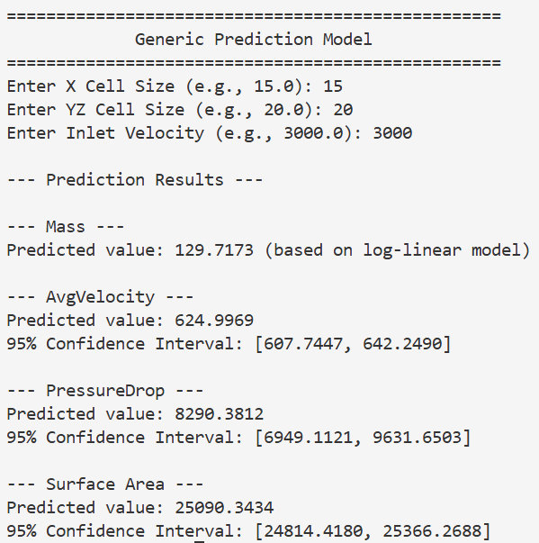
2. Model Prediction Result Analysis
Predictive models and effects
Due to the excellent planar properties of MASS, the log-linear model yielded better prediction results. The UK model was used for the other three variables.
The UK model has the advantage of outputting not only the predicted mean but also a confidence interval for the predicted value. The following figure shows the prediction results after running the code:

Slide 14
3. Inverse Design

Slide 15
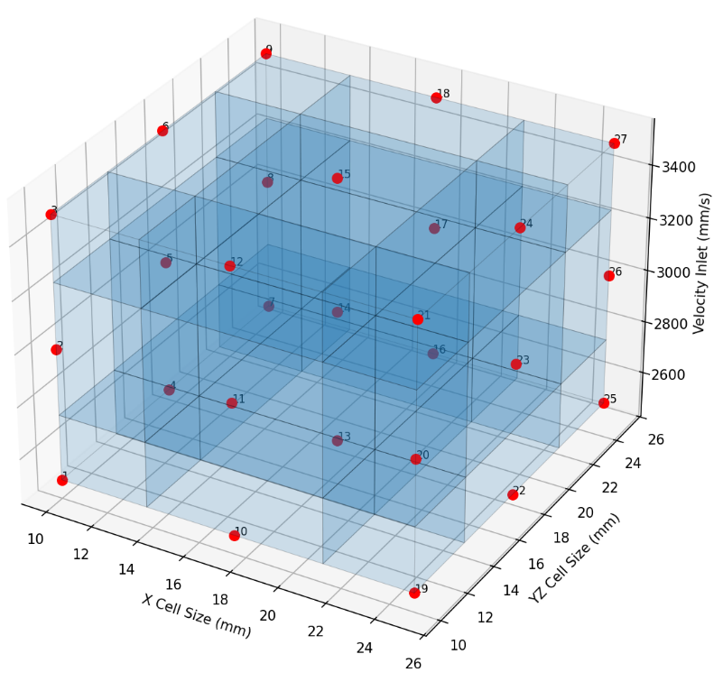
3. Inverse Design – Method introduction
Inverse Design Method-After some experiments, it was found that the problem is non-convex, thus we perform inverse design considering prediction variance through a hybrid strategy of grid initialization combined with sequential quadratic programming (SLSQP).
Reasons for Choosing the Inverse Design Method
Grid initialization ensures that the optimization process searches the entire parameter space, avoiding local optima. The SLSQP algorithm, given a given initial point, quickly converges to the local optimum, ensuring optimization efficiency.
Inverse Design Process
Grid Initialization: A uniform grid sampling strategy is used to provide a comprehensive search starting point for subsequent optimization.
Sequential Quadratic Programming (SLSQP) Optimization: Each initialization point is optimized to obtain the locally optimal design parameter combination.
Final Design Parameter Output: By comparing the optimization results of all initialization points, the globally optimal design parameter combination is selected.
Partitioning the input parameter space

Slide 16
4. Inverse Design Result Analysis

Slide 17
4. Model Prediction Result Analysis
After optimization, we obtained the optimal result of reverse design.
Global Optimum X Cell Size: 15.3594 mm
Global Optimum Yz Cell Size: 24.8454 mm
Global Optimum Inlet Velocity: 2807.7346 mm/s
Maximum Surface Area Achieved: 24229.9011 mm^2
s.t.
Mass: 125.0000 g(Constraint:<125 g)
Pressure Drop: 6614.6814 Pa(Constraint:<8000 Pa)
Average Velocity: 621.6901 mm/s (Constraint: > 520 mm/s)
If we consider that the surrogate model has a prediction bias, the optimization results are as follows:
 | Constraints |  |  | Design Variables |  |  | Optimization Objectives
n_std | Mass | Pressure Drop | Avg Velocity | X | YZ | Velocity Inlet | Surface Area
0 | 125.00 | 8000.00 | 638.65 | 15.34 | 25.00 | 3015.33 | 23188.85
1 | 124.76 | 7681.58 | 629.45 | 15.80 | 25.00 | 2974.36 | 23162.94
2 | 124.52 | 7364.39 | 616.27 | 16.11 | 25.00 | 2933.53 | 23141.39

Slide 18
5. Conclusion

Slide 19
5. Conclusion
Several surrogate models are established, and the UK model is used to
achieve a more accurate prediction effect, and the confidence interval
of the predicted value could be output.
An algorithm was established to calculate the inverse design results,
find the global optimal point, and set robust conditions to obtain the
optimal parameter combination.
In the future, by further optimizing the model and incorporating more
physical mechanisms such as fluid laws, we will establish a more com-
plete “physics+data”driven model.

Slide 20
Thanks For Your Listening

